Slide 1
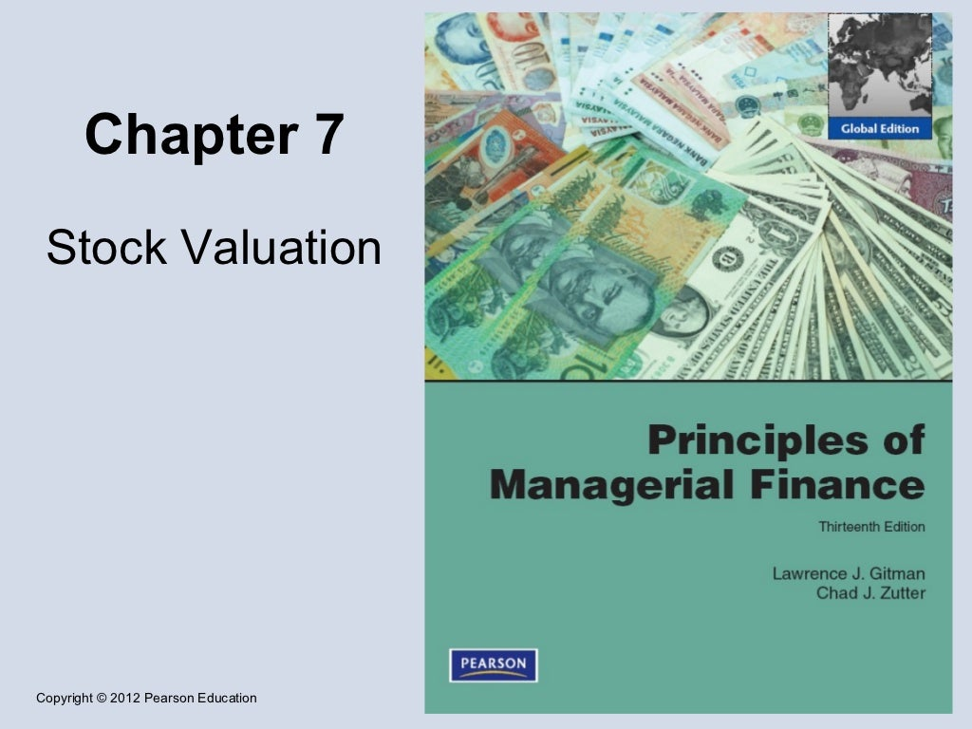
Chapter 2

Slide 2
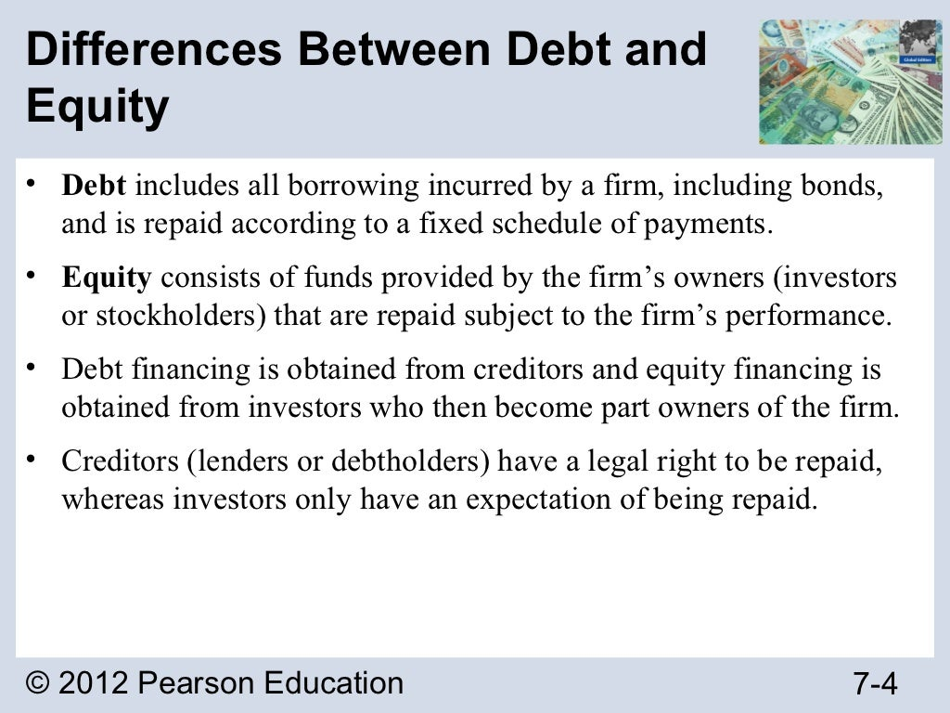

Slide 3
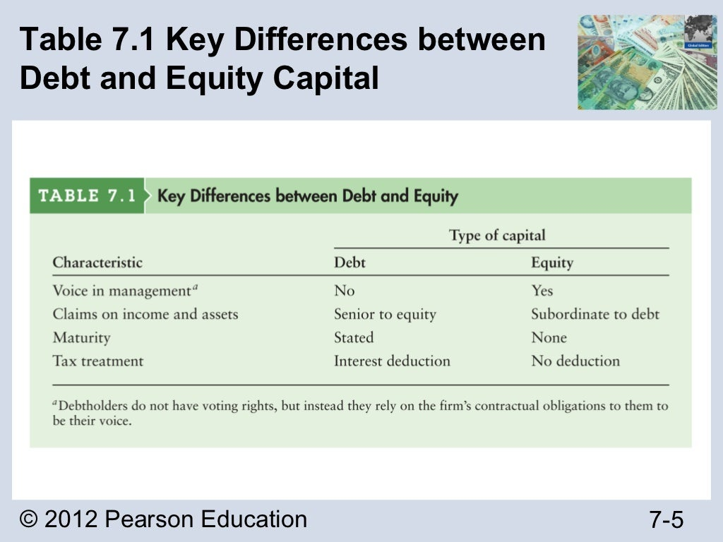

Slide 4
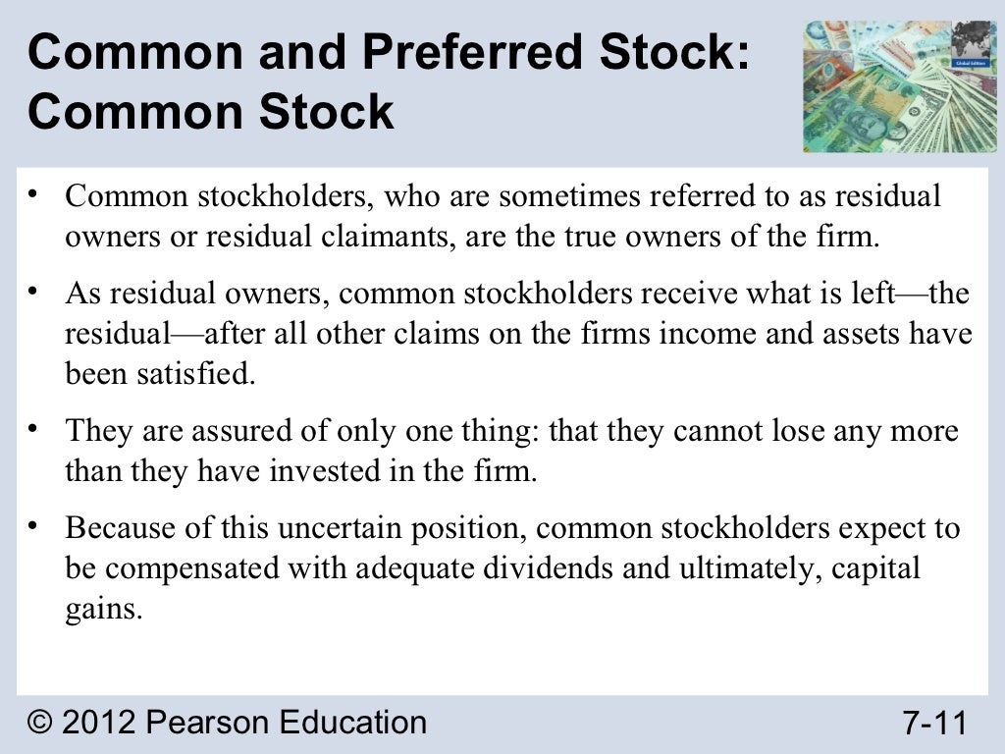

Slide 5
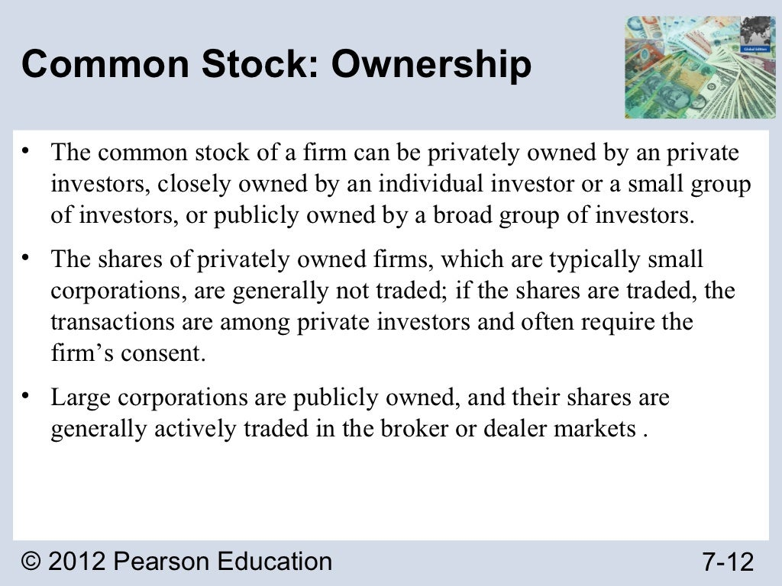

Slide 6
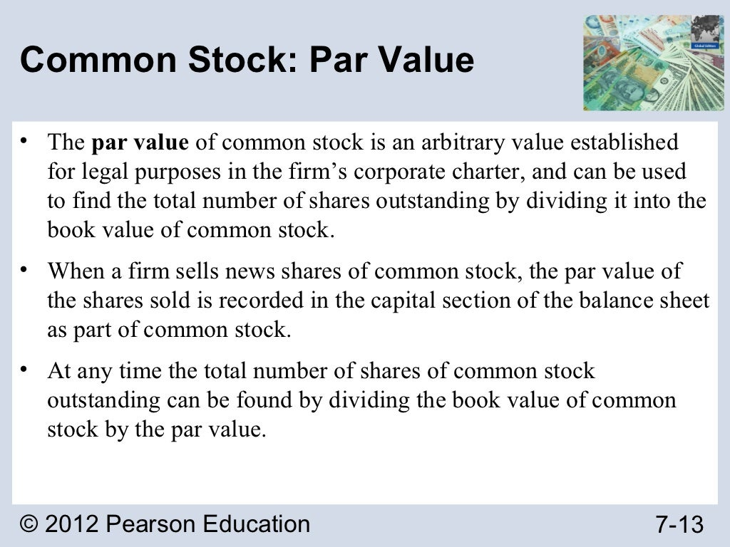

Slide 7
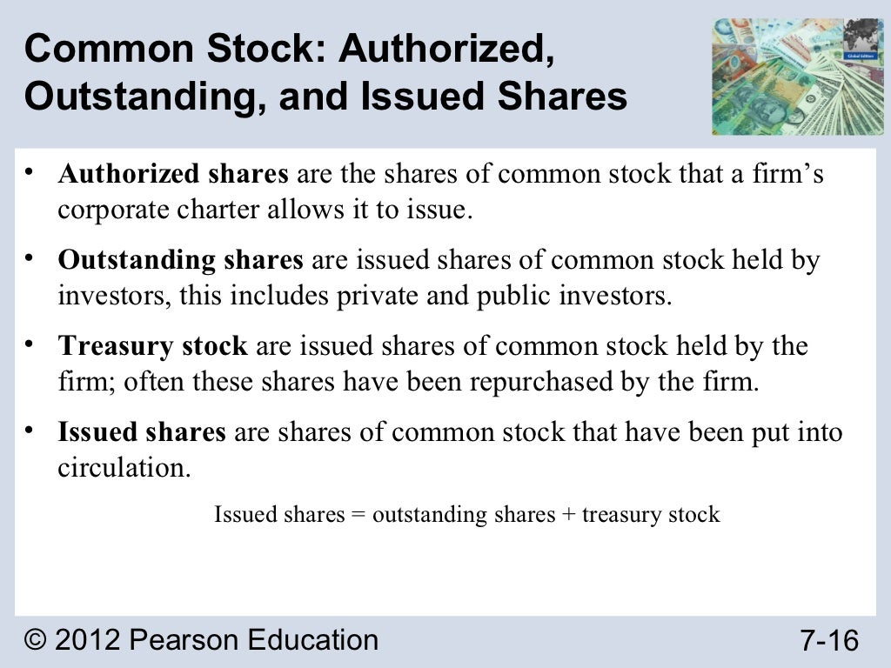

Slide 8
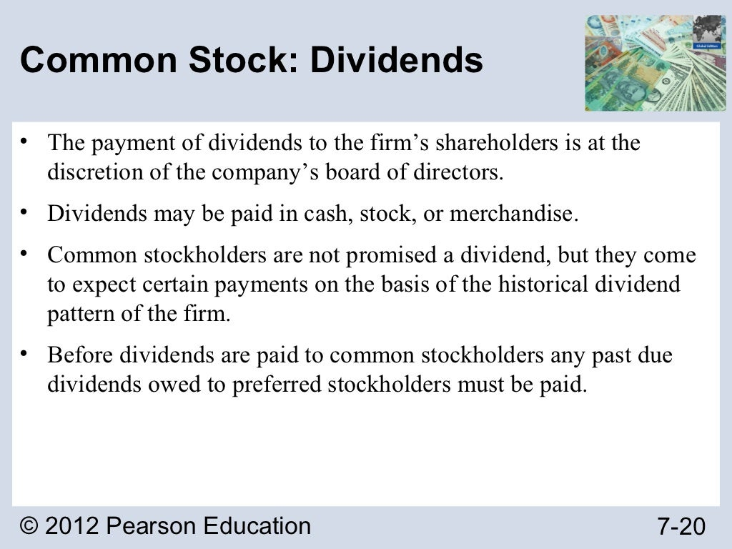

Slide 9
Common Stock Valuation
Common stock valuation is the process of determining the value of a share of stock in a company.
The value of share should represent that percentage of the company's worth.
The first is based on looking at fundamentals such as discounted cash flow

Slide 10
What is discounted cash flow
Discounted cash flow (DCF) is a valuation method used to estimate the value of an investment based on its expected future cash flows.
DCF analysis attempts to figure out the value of an investment today, based on projections of how much money it will generate in the future.

Slide 11
Why Common Stock Valuation Important
Stock valuation is important because it can be used to identify whether a stock is overvalued, undervalued, or is at market price.
Investing in a company that is overvalued provides a huge downside risk. Whereas, investing in a company that is undervalued can significantly reduce the risk.

Slide 12
What is Constant Growth rate model?
The Constant Growth Model is a way of share evaluation. Also known as Gordon Growth Model, it assumes that the dividends paid by the company will continue to go up at a constant growth rate indefinitely.
It helps investors determine the fair price to pay for a stock today based on future dividend payments

Slide 13
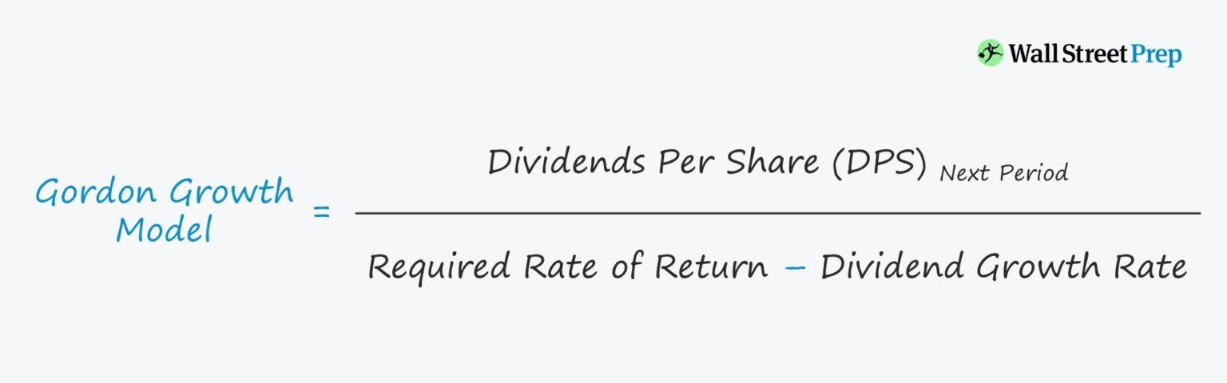
Gordon Growth Model Formula

Slide 14
Constant Growth Model Example
If a company’s shares are trading at $100 per share and a minimum required rate of return of 10% (r) with plans to issue a $4.00 dividend per share (DPS) next year, which is expected to increase by 5% annually (g).
Value Per Share = $4.00 DPS / (10% Required Rate of Return – 5% Annual Growth Rate)
Value Per Share = $80.00
In our example, the share price of the company is overpriced.

Slide 15
Constant Growth Model Example
Dividends Per Share (DPS) – Current Period: $5.00
Required Rate of Return (Ke): 8.0%
Expected Dividend Growth Rate (g): 3.0%
What will be Share worth today?

Slide 16
Constant Growth Model Example
Consider a company that pays a $5 dividend per share, requires a 10 percent rate of return from investors and is seeing its dividend grow at a 5 percent rate.
What will be Share worth today?

Slide 17
Valuing the Entire Corporation
A business valuation is a general process of determining the economic value of a whole business or company unit.
Different methods of evaluating the Corporation is below.

Slide 18
Market Capitalization
Market capitalization is the simplest method of business valuation. It is calculated by multiplying the company’s share price by its total number of shares outstanding.

Slide 19
Example of Market Capitalization
As of January 3, 2018, Microsoft Inc. traded at $86.35. with a total number of shares outstanding of 7.715 billion, the company could then be valued at $86.35 x 7.715 billion = $666.19 billion.

Slide 20
Book Value Method
This is the value of shareholders’ equity of a business as shown on the balance sheet statement.
The book value is derived by subtracting the total liabilities of a company from its total assets.

Slide 21
Liquidation Value
Liquidation value is the net cash that a business will receive if its assets were liquidated and liabilities were paid off today.
This is by no means an exhaustive list of the business valuation methods in use today. Other methods include replacement value, breakup value, asset-based valuation and still many more.

Slide 22
Stock Market Equilibrium
Equilibrium is the state in which market supply and demand balance each other, and as a result prices become stable.

Slide 23
Stock Market Equilibrium
Generally, an over-supply of goods or services causes prices to go down, which results in higher demand—while an under-supply or shortage causes prices to go up resulting in less demand.

Slide 24
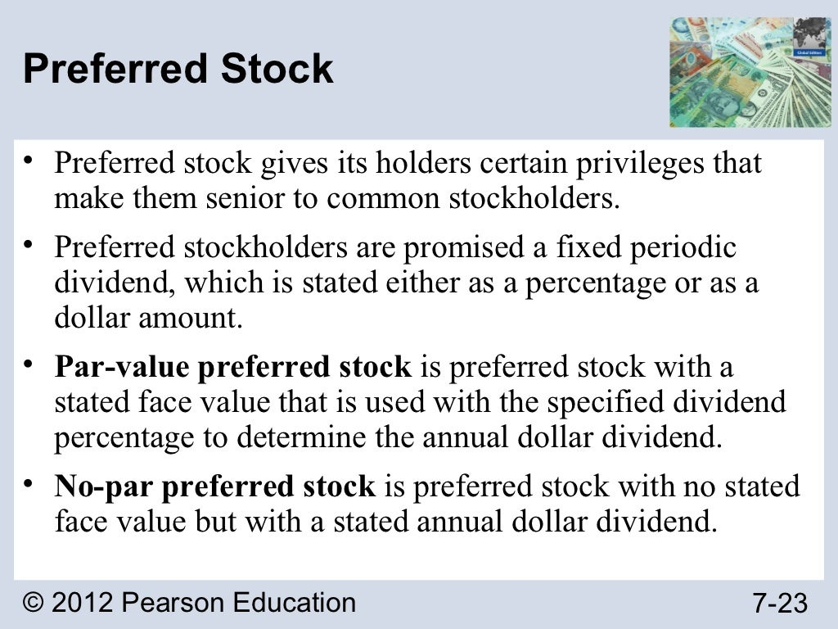

Slide 25
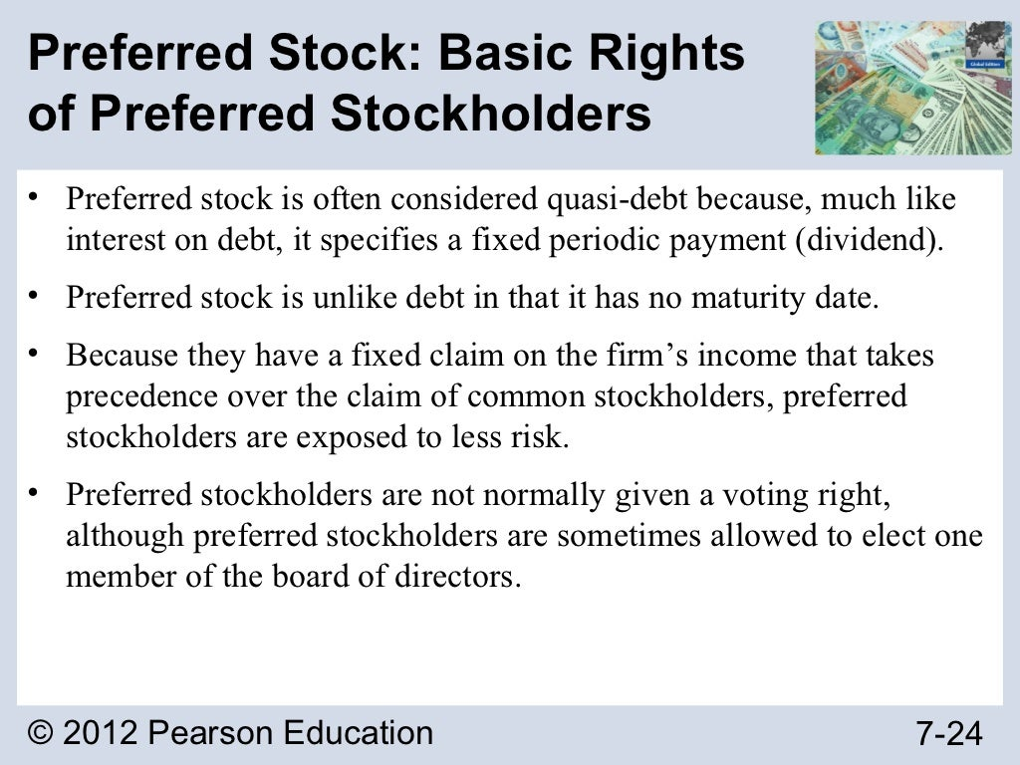

Slide 26
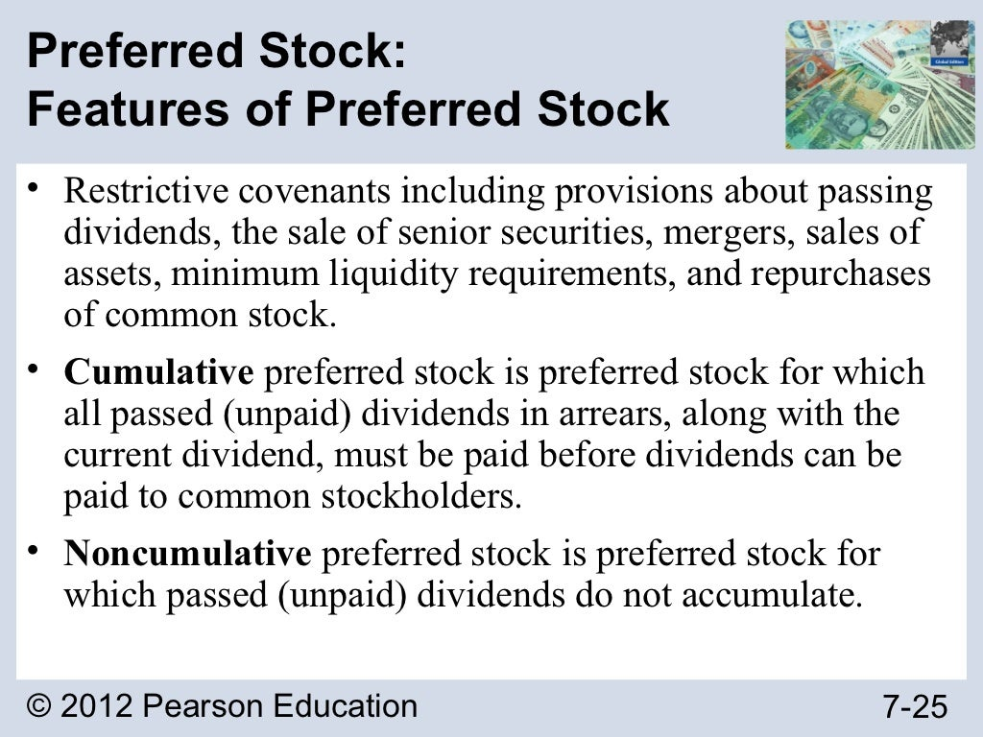

Slide 27
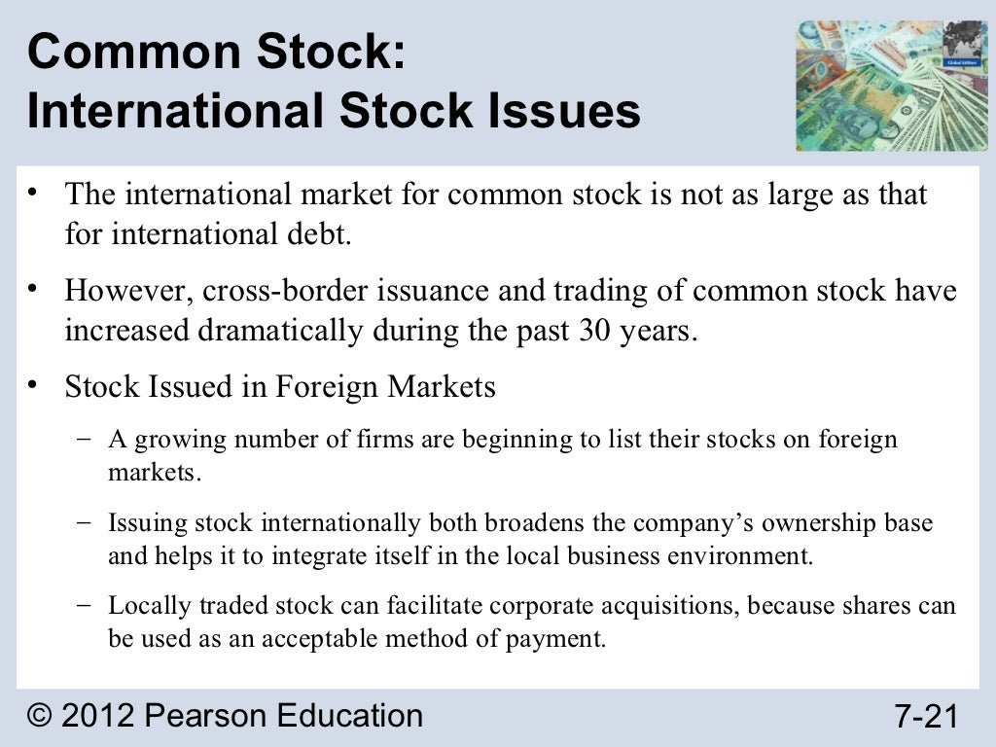

Slide 28
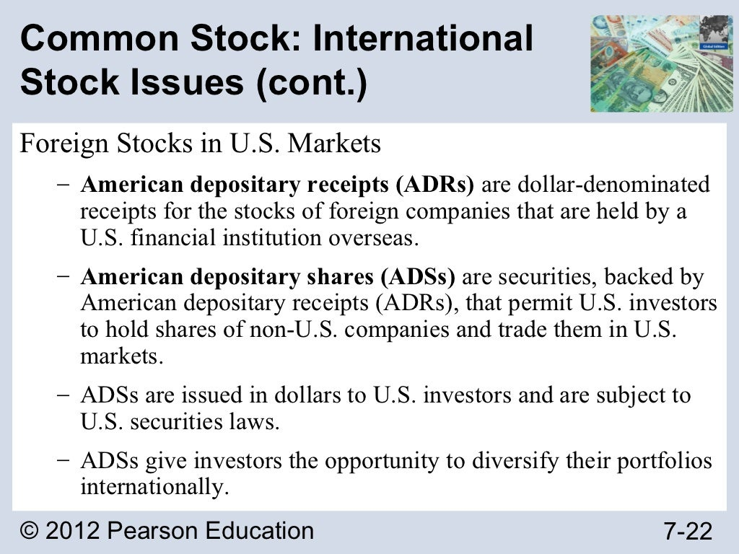

Slide 30
Valuing Preferred Stock
Valuation Models
If preferred stocks have a fixed dividend, then we can calculate the value by discounting each of these payments to the present day. This fixed dividend is not guaranteed in common shares. If you take these payments and calculate the sum of the present values into perpetuity, you will find the value of the stock.
For instance, person A is an investor who wants to invest in a straight preferred stock that pays annual dividends of $40. Considering the risk, the market will consider a discount rate of 10%. Compute the preferred stock value of person A.

Slide 31
Valuing Preferred Stock
Formula for Valuing Preferred Stock
​V=D/r

